Slide 1
Real Time welding
Alex Rhodes, Timmy Hoo, Sean Meals, Rafael Guerrero
Notes:
This is just a template! Make your presentation unique to your group! Use a different theme, get creative. Make your presentation stand out. This is just a starting point to make sure you hit everything,

Slide 2

Team Members
Alex Rhodes
Sean Meals
Rafael Guerrero
Timmy Hoo
Team Captain
Will lead the programming and the system interfaces
With my back around in Solidworks I will build the enclosure
Has expertise in power systems in specifically in protection and controls
He will be focusing on the voltage and current signals on the welder
Has an expertise in control systems and mathematics.
He has previous experiences in proving mathematical theories and calculating different values through different axis
Focus will be the gyroscope and angle measurements
Has expertise in both control systems and coding with microcontrollers.
Will be focusing on feedback systems to inform welders of current state

Slide 3
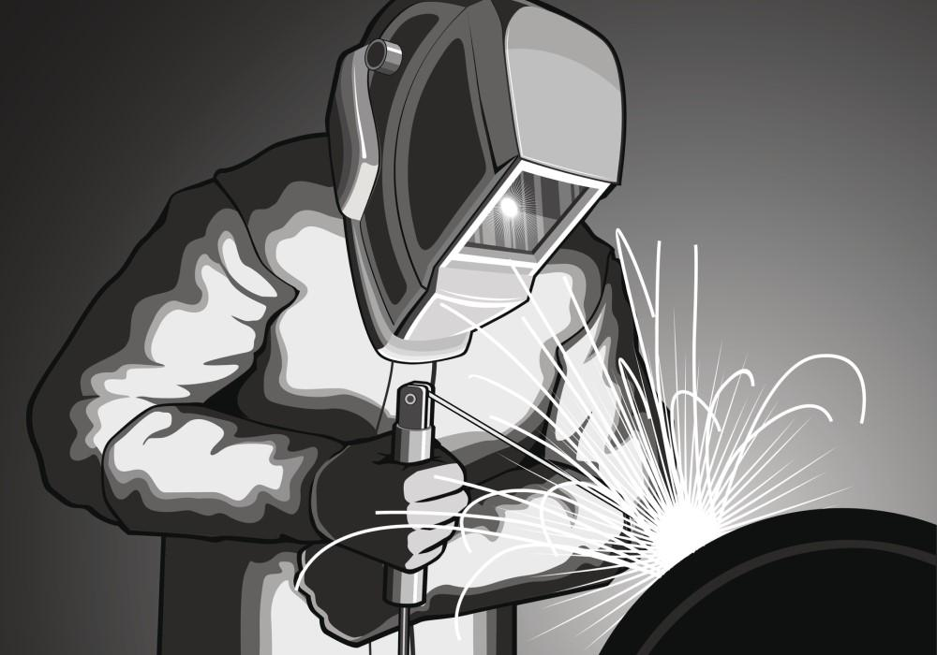
Introduction
POV Statement: Welders need real-time data feedback because it will enhance the welders’ skills and reduce waste/time.
With these goals set out we would like to create a system that easily attaches to an existing welder to get real time voltage and current readings along with travel speed and angle from other sensors.
This will all be integrated into an easy-to-use smartphone app that wirelessly connects to the computers.
Within the smartphone application the welder will be easily able to change the specifications of the weld that they are performing
Notes:
Alex

Slide 4
Problem Statement
POV statement: The current welding process often lacks real-time feedback and monitoring, which can result in welds with poor quality and durability. The lack of immediate feedback on weld characteristics such as arc length, electrode angle, and travel speed can lead to inefficiencies and costly errors. Traditional methods off providing feedback, such as visual inspection or external measuring devices, can be time-consuming, impractical, and expensive. The evidence of these issues can be seen in our observations and interviews with people in the field.[3] With the arc created during the welding process if you try to take a picture or record anything with a normal camera it will become distorted and unusable causing us to produce different methods. Therefore, the objective of this project is to develop a mobile application that connects to the main computer on the welder that handles the signals. That will then be passed to the users' headphones for real-time feedback. The application will provide audio signals to alert welders when there are deviations from the desired welding conditions, allowing them to make immediate adjustments to their welding techniques. The application will also have a database to store information about the welds, providing welders with a historical record of their welding work. Ultimately, the project aims to improve the efficiency and effectiveness of stick welding by providing real-time feedback to welders. The stakeholders for this project are the group members and our advisors. The users for this product would be new welders or welders that want to get better and know the soundness of their welds.
Notes:
Timmy

Slide 5

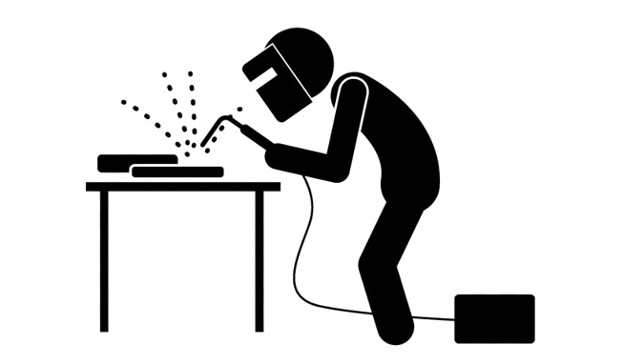
Research
Use of primary sources
Articles and Literature
Welding Shop visits
Interviews
Consumers
Investors
Notes:
Rafael (Done)

Slide 6
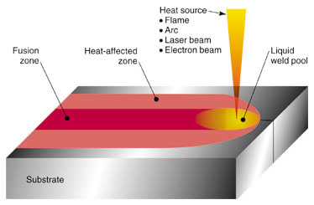
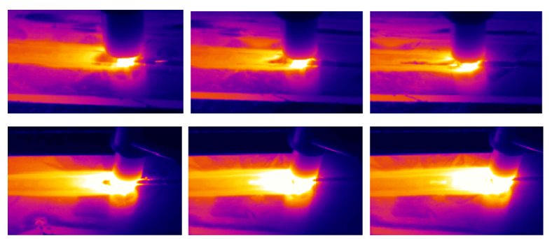
Literature Review
Thermal Imagining can be utilized to determine the quality of a weld. Photographing weldments directly after they are welded provides the best results (IEEE, Li).
The importance of DC voltage measurement devices and how factors such as internally generated heat can cause inaccuracies (ICEPE-ST, Tingting).
Weld pool analysis using UV and IR sensors can measure plasma intensity to determine tensile strength (IEEE, Kang).
Notes:
Sean (Done)

Slide 7
Observations
We learned that welders don't have enough information while welding
We saw how difficult it is to weld without more information and how helpful having the information is to improve some of the welds
We learned about how much variation there is in welding and how we will have to input a lot of customization
Notes:
Alex

Slide 8
Interviews
Learned the problems people who would use our product have
Jason Keely's problem – variability of flux stick that can affect weld
Eduardo Vega's problem – welds are poor due to the wrong angle at times
Most Valuable Insights
Kyle Juretus' Insight – Use of small raspberry pi but should first work on connecting with a Bluetooth modulation
Jonathan Kim's Insight - benefits of laser beam welding is fuses two metals together into one, deep penetration, and high speed
Notes:
Rafael (Done)

Slide 9
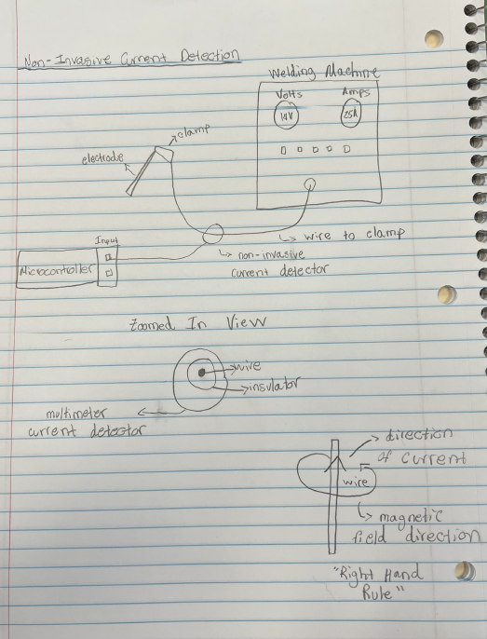
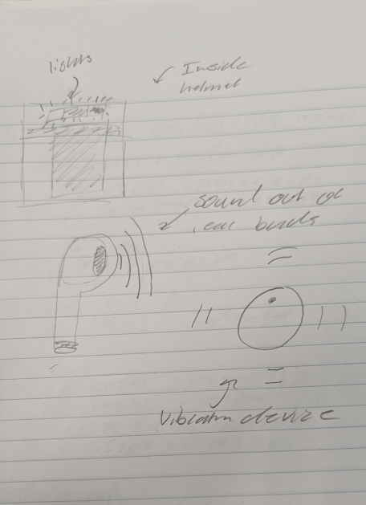
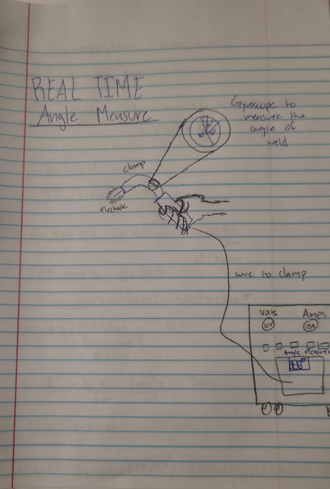
Brainstorming
Non-invasive current detection
Feedback Response
Real Time Angle Measure
Notes:
timmy

Slide 10
Criteria and Constraints
Constraint 1: Easy to use for anyone
Constraint 2: Can be used on any type of welding machine
Constraint 3: Non invasive to the Welder
Constraint 4: Quickly accessible
Criteria 1 : Must provide accurate data to user
Criteria 2 : Must enhance welders skill faster than normal
Notes:
Sean

Slide 11
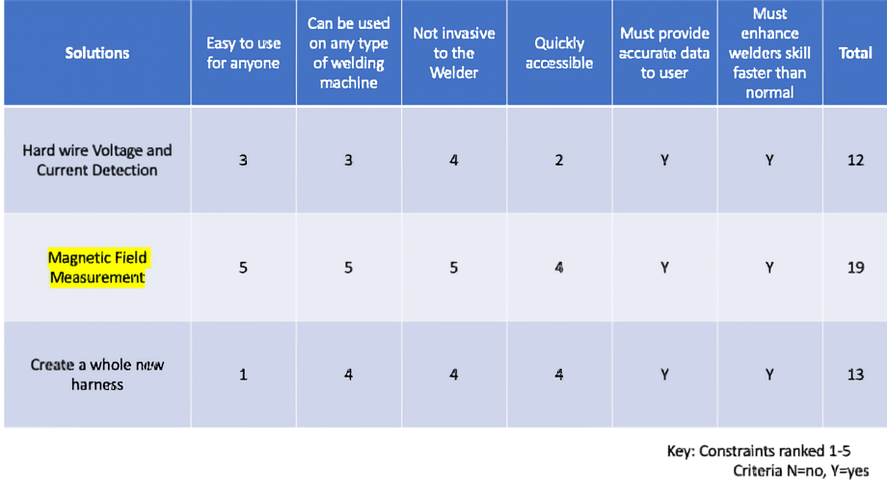
Decision Matrix
Notes:
Alex

Slide 12
Winning Design
Our solution includes a measuring device that detects the magnetic field strength. This would allow us to detect voltage and current on any type of welding machine regardless of manufacturer. Since this type of detection is noninvasive it can be easy to use for anyone. This solution does not affect the welder since there are no extra steps that would make the process complex. Using magnetic field strength to detect current is widely used in industry and provides accurate results within a certain range. Welders’ skills will improve since the real-time data provided can allow them to adjust and correct errors as they happen. All the examples and descriptions provided allowed us to decide that this would be the best solution. Based upon our results from the decision matrix, this solution ranked the highest compared to our hard-wired solution and creating a whole new wiring harness.
Notes:
Timmy

Slide 13
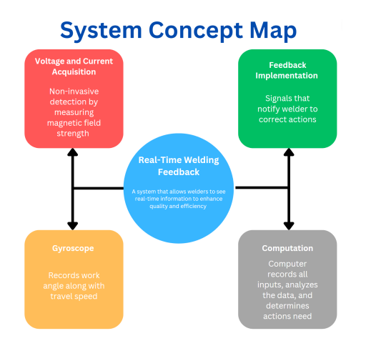
System Diagram
Notes:
Sean (Done)

Slide 14
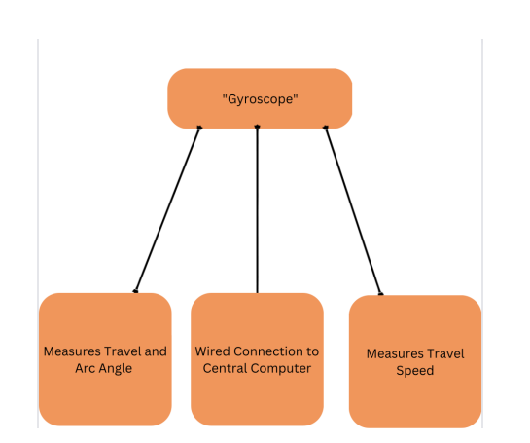
Sub-System (Gyroscope)
Notes:
Sean (Done)

Slide 15
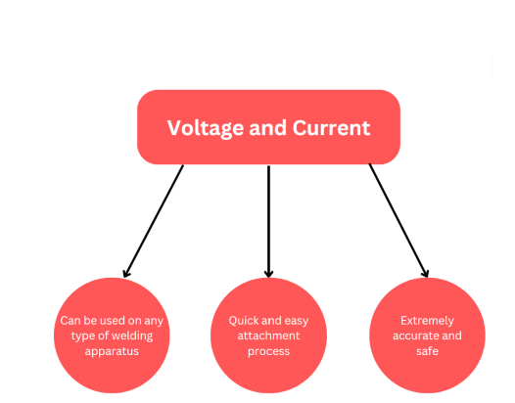
Sub-System (Voltage and Current)
Notes:
Sean (Done)

Slide 16
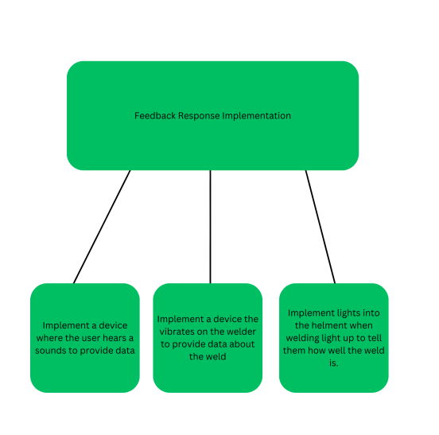
Sub-System (Feedback Response)
Notes:
Sean (Done)

Slide 17
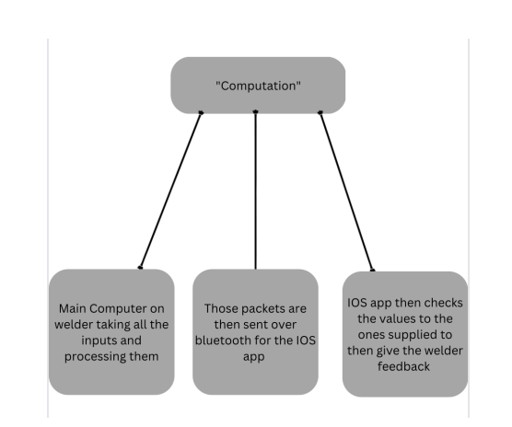
Sub-System (Computation)
Notes:
Sean (Done)

Slide 18
Materials
Steel: For testing of the sensors and calibrating
Flux sticks: needed for stick welding
Screws: Needed to assemble the systems
Wire: This will be needed to connect all the sensors to the Arduino
Wireless earbuds: To give feedback response to the welder on what he should do to improve his weld
Arduino Mega: For the input of sensors and management software that packs up the Bluetooth packets for transmission to the iOS app
Gyroscope Sensor: This sensor will be attached to the handle of the welding clamp to measure travel motion.
Commercial 400A AC/DC Clamp Meter: this will be used to measure the current and voltage going through the lines
Welding Jackets and Gloves: will be needed for our protection
Auto Tinting welding helmet: will help us be able to start the weld since we are beginners
Bluetooth Add-on Card: This will give the Arduino Bluetooth capability for transfer to ios app
Notes:
Alex

Slide 19
Tools
Unity Student Plan: This is used to help create the app on a windows device and not purchase a MacBook to help
Xcode: The code to use to program the app for the background to complete the calculations
Git repository: needed to be able to collaborate on the code
Apple Developer Account- this will be needed to create our app and test it
Welder: to practice and see how we how to model our project off
Notes:
Timmy

Slide 20
Budget
Item | Manufacturer | Cost-Per Unit | Num. Units | Total Cost
Steel | Sponsor | 0 | - | -
Flux Sticks | Sponsor | 0 | - | -
Screws | On Campus | 0 | - | -
Wire | On Campus | 0 | - | -
Wireless Earbuds | JBL-California, US | 29.99 | 1 | $29.99
Arduino Mega | Arduino-Italy | 48.20 | 1 | $48.20
Gyroscope | Adafruit-New York, NY | 17.95 | 1 | $17.95
Clamp Meter | Aicevoos- Wuhan, China | $39.99 | 1 | $39.99
Notes:
Rafael

Slide 21
Budget Continued
Item | Manufacture | Cost per Unit | Num. Units | Total Cost
Welding gloves and Jackets | Sponsor | 0 | - | -
Auto Tinting Helmet | Sponsor | 0 | - | -
Unity | Unity- California | 0 | - | -
Xcode | Apple- California | 0 | - | -
Apple Development Account | Apple- California | 0 | - | -
Welder | On Campus | 0 | - | -
Bluetooth Add-on Card | DSD Tech- Wisconsin, US | $9.99 | 1 | $9.99
Final Total |  |  |  | $ 146.12
Notes:
alex

Slide 22
Schedule
1: Find Components (Apr 27-Apr 27)
2: Find Sensor (Apr 27-Apr 28)
3: Find Software for sensor(Aug 21-Aug 25)
4: Connect to computer(Aug 28-Sep 22)
5: Get sensor values(Sep 25-Nov 10)
6: Get main computer running on Linux (Aug 21-Aug 23)
7: Find the correct connectors to attach sensors(Aug 24-Aug 28)
8: Create integrating sensor software(Aug 29-Sep 22)
9: Bring sensors into the management software(Sep 25-Sep 29)
10: Create the software for Bluetooth communication of sensor values(Oct 2-Oct 20)
11: First packet transmission(Oct 23-Oct 25)
12: Software to check the sensor readings against known values to know if out of range(Oct 26-Nov 10)
13:Learn Xcode(May 22-Jul 31)
14: Find the api’s that we will need to implement(Aug 21-Aug 25)
15: Code the main body and UI of the app(Aug 28-Nov 10)
16: Integrate the bluetooth api to get the packets from computer(Nov13-Dec 1)
17: Create user selections for different types of welds and metals. (Dec 4 - Jan 1)
18: Add different languages to the app (Jan 2 - Jan 19)
19: Find sensor (Apr 27 - Apr 28)
20: Find software and sensor (Aug 21 - Aug 25)
21: Get connected to main computer (Aug 28 - Sep 29)
22: Get first sensor values (Oct 2 - Nov 7)
23: Calibrate it for our needs to travel angle and travel (Nov 8 - Dec8)
24: Mitigate interference and bugs (Dec 11 - Jan 12)
25: Mitigate interference (Dec 11 - Jan 19)
26: Find headphones that work with Bluetooth (Apr 27 - Apr 28)
27: Connect the headphones to the main computer (Aug 21 - Aug25)
28: Get the correct ranges to notify the welder (Aug 28 - Sept 15)
Notes:
Sean

Slide 23
Timeline
Background info/observation
We evaluate the problem and produce solutions and how to put togethor our device
App
Feedback Response
We use the data from the devise and the processing power of the app to give response on the weld
Test/Finalize
We test the device,app,feedback response works and fixes any bugs that might arise
We learn how to code in Xcode for our app and how to connect with device.
Device
We learn and produce our device with the gyroscope,bluetooth, and voltage/current sensor
Notes:
This slide is an example of how to format your schedule of tasks for the presentation
Alex

Slide 24
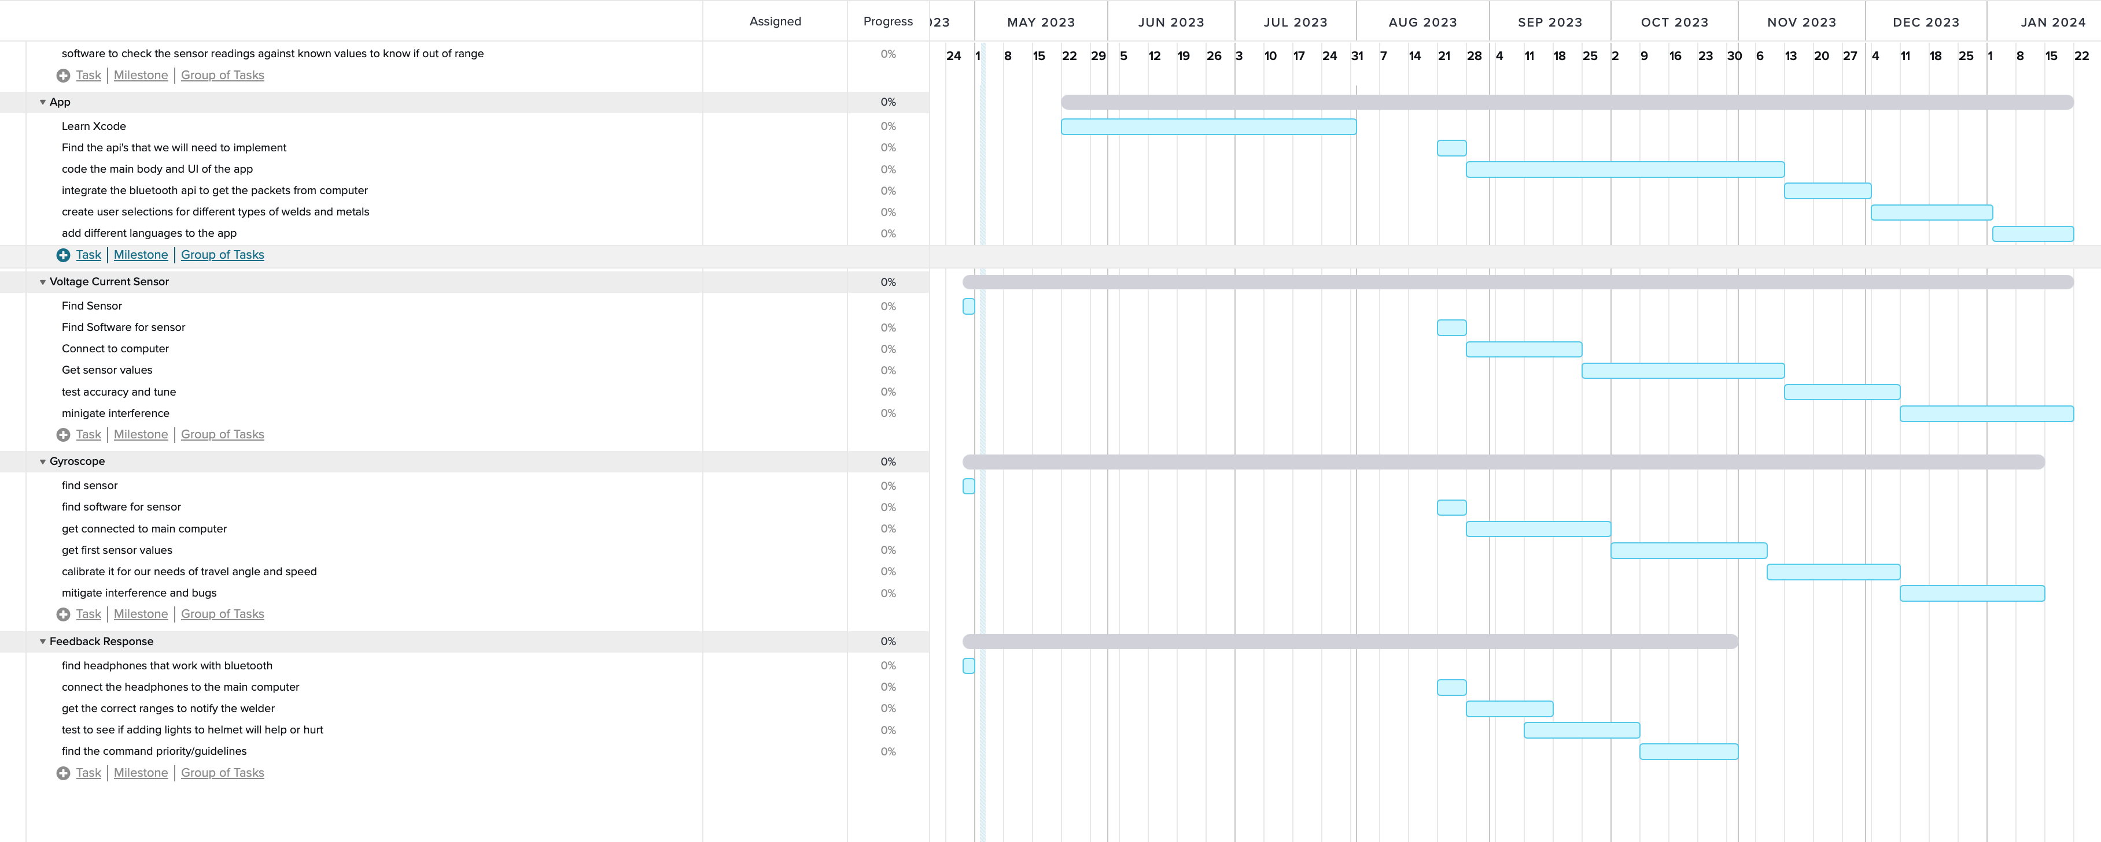
Gantt Chart
Notes:
Alex

Slide 25

Acknowledgements
Joe Zebrowski – Mentor
Dr. Kulkarni – Mentor
Rafael Guerrero – Interviewee
Dr. Juretus – Interviewee
Eduardo Vega – Interviewee
Jason Keely – Interviewee
Adam Ritter – Interviewee
Joey LaMorte – Interviewee
Jonathan Kim – Interviewee
Dr. Klein – Professor
Notes:
Rafael

Slide 26
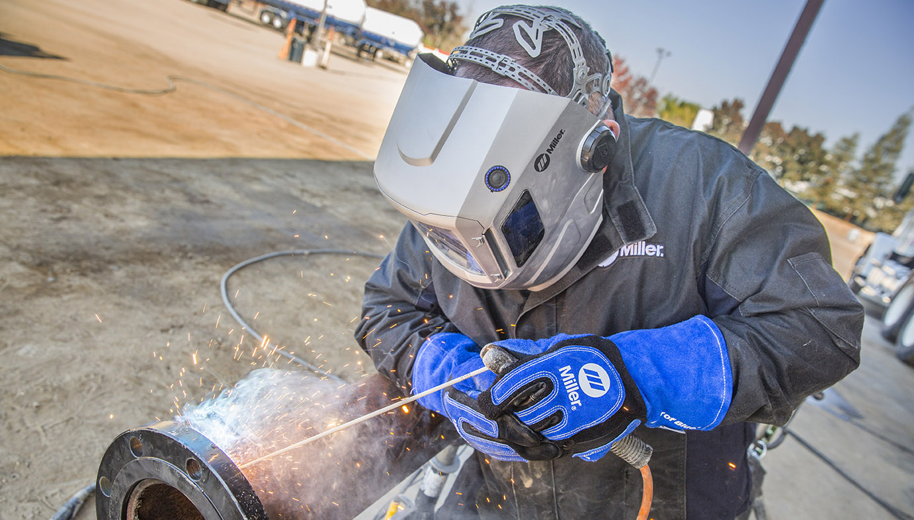


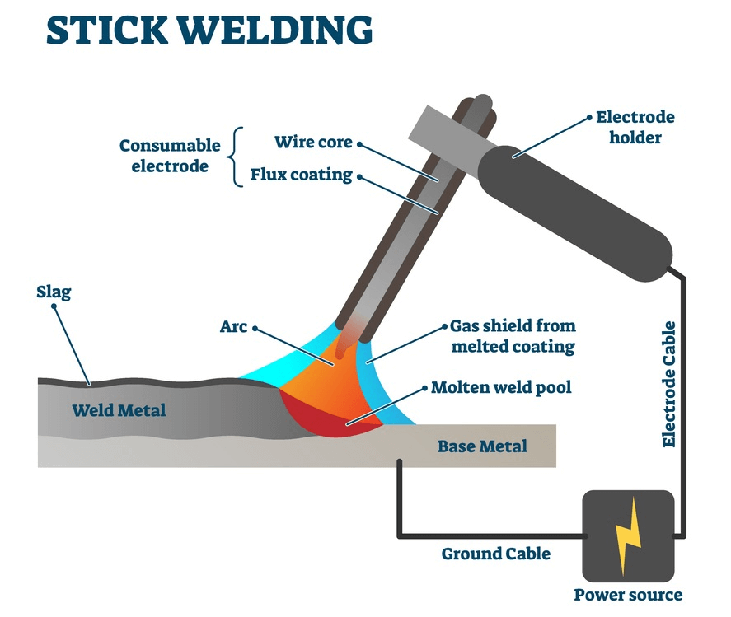
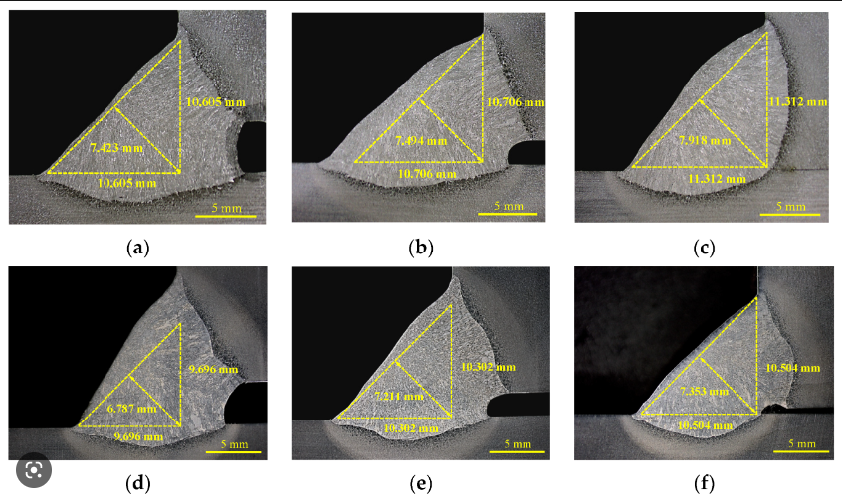

Summary
In conclusion, we are building a system that will enhance a welder's skill by providing them real time data feedback. A computer will analyze this data and provide corrections to the welder through audible messages. Some of the data being collected will include voltage and current measurements, travel and work angle, and travel speed.
Notes:
Sean

Slide 27
Bibliography
A Adan et al. Fusion of thermal imagery and LiDAR data for generating TBIM models. 2017. isbn: 9781509010127. url: https://ieeexplore.ieee.org/document/8234261.
Ario Sunar Baskoro and Irwan Haryanto. “Development of travel speed detection method in welding simulator using augmented reality”. In: ICAC-SIS 2015 - 2015 International Conference on Advanced Computer Science and Information Systems, Proceedings. Institute of Electrical and Electronics Engineers Inc., Feb. 2016, pp. 269–273. isbn: 9781509003624. doi:10.1109/ICACSIS.2015.7415194. url: https://ieeexplore.ieee.org/document/7415194.
H.B. Chen et al. “Adaptive control on wire feeding in robot arc welding system”. In: 2008 IEEE Conference on Robotics, Automation and Mechatronics. IEEE, Sept. 2008, pp. 119–122. isbn: 978-1-4244-1675-2.doi: 10.1109/RAMECH.2008.4690868.
Moonyoung Chung et al. “A study on measuring system of Submerged Arc welding for panel butt joint in shipyard”. In: International Conference on Control, Automation and Systems. 2013, pp. 1623–1627. isbn:9788993215052. doi: 10.1109/ICCAS.2013.6704190.
IEEE Staff and IEEE Staff. 2012 12th International Conference on Control, Automation and Systems (ICCAS). isbn: 9788993215045
Tomasz Marek Lubecki and Fengjun Bai. “Weld quality assessment based on arc sensing for robotic welding”. In: 2015 IEEE International Conference on Advanced Intelligent Mechatronics (AIM). IEEE, July 2015,pp. 1496–1501. isbn: 978-1-4673-9107-8. doi: 10.1109/AIM.2015.7222753.url: http://ieeexplore.ieee.org/document/7222753/.
Xuange Peng and Ying Xiao. “An embedded electric meter based on bluetooth data acquisition system”. In: 2nd International Workshop on Education Technology and Computer Science, ETCS 2010. Vol. 1. 2010,pp. 667–670. isbn: 9780769539874. doi: 10.1109/ETCS.2010.624. url: https://ieeexplore.ieee.org/document/5458588.

